Slide 1
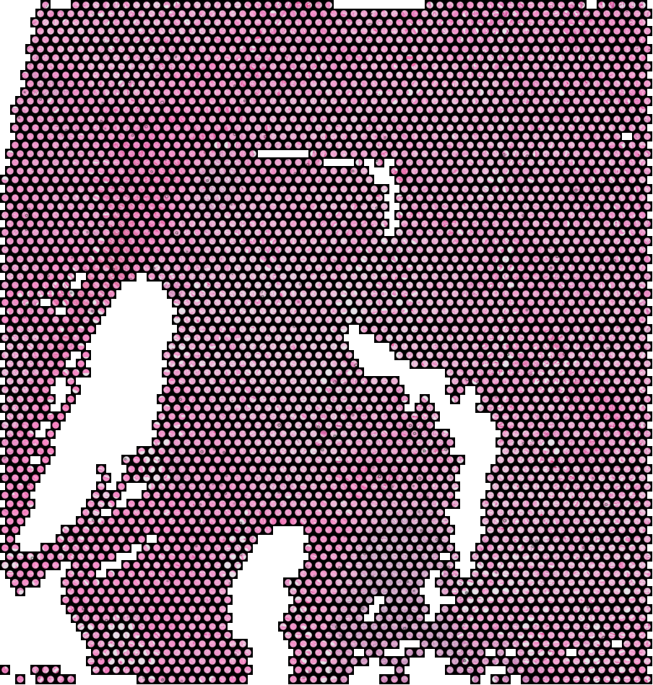
SPATIAL TRANSCRIPTOMICS RESEARCH
Spatial Transcriptomics and Multimodal
Metastatic Biomarker Discovery
Results and What We Learned
Research Advisors: Dr. Ashiq Masood and Dr. Mohsin Bilal
Date: 29 June 2026
TISSUE TO MOLECULES TO PREDICTION
Notes:
This is a results update. The goal of the project is to flag which tumour regions are prone to spread to the liver, using a routine H and E slide at the time of prediction. I will walk from the question, to how we built a trustworthy signal, to what a plain slide can and cannot tell us, and finish with an honest verdict and next steps.

Slide 2
What this talk covers
1
2
3
4
The question and the data
A signal we can trust
What a plain H&E can do
What we learned and next
What we predict and the six tissues
The confound, the leaving program, one worked example
How far the slide alone gets us
Honest scorecard and the way forward
Short version: the biology we found is real and checks out against outside data. A plain slide today reads how much tumour is present, and not yet the finer movement state.
Notes:
Four parts. First the question and the six samples. Second, how we built a signal we can trust, including the one confound that could have fooled us, and a single spot worked through end to end. Third, how far a plain slide gets us on new patients. Fourth, the honest scorecard and what would push it further.

Slide 3
PART 01
The clinical question and the cohort
The question and the data
What we predict, and the six tissues it is built on
Notes:
We want to read metastasis risk from a routine slide. Spatial transcriptomics is the teacher during training only. At prediction time we want only the H and E slide.

Slide 4
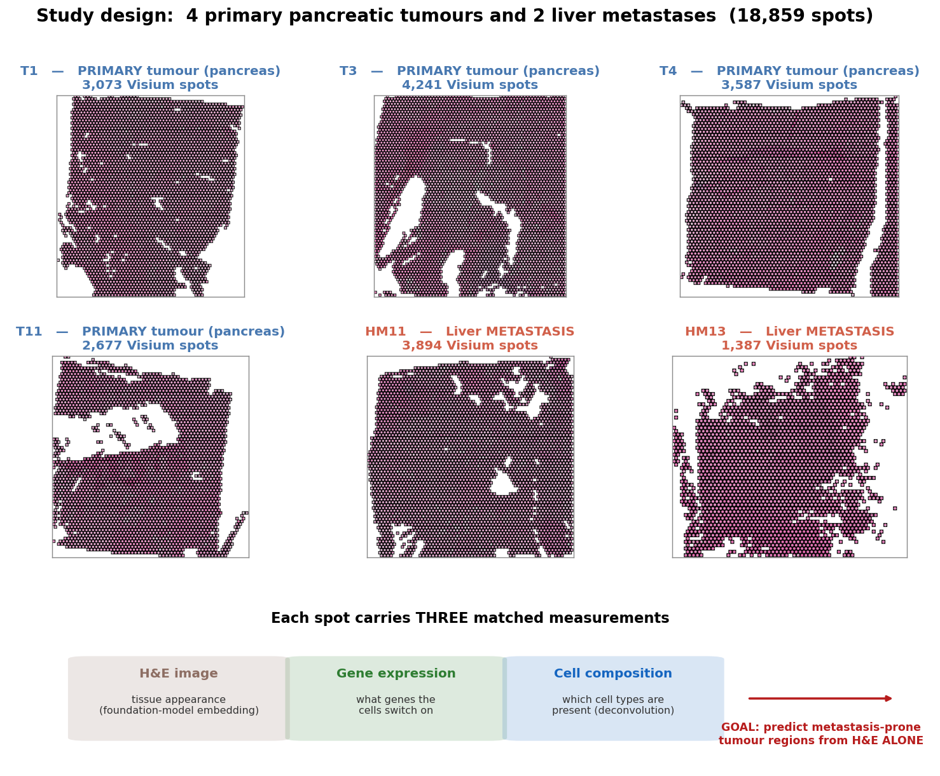
The question and the data
04
Goal: flag metastasis prone tumour regions from a routine H&E slide. Transcriptomics teaches the model during training only.
Notes:
Six tissues. Four primary pancreatic tumours and two liver metastases. Each spot has three matched readings, the H and E image, the gene expression, and the cell makeup. Only patient 11 has both a primary and its own metastasis. The constraint from the clinic is that at prediction time we use the slide alone.

Slide 5
PART 02
Building a signal we can trust
A signal we can trust
The confound we avoided, the program we measure, and one spot worked through end to end
Notes:
Before trusting any score we had to rule out the obvious trap, then define a signal inside the primary tumour, then show one spot end to end so it is not a black box.

Slide 6
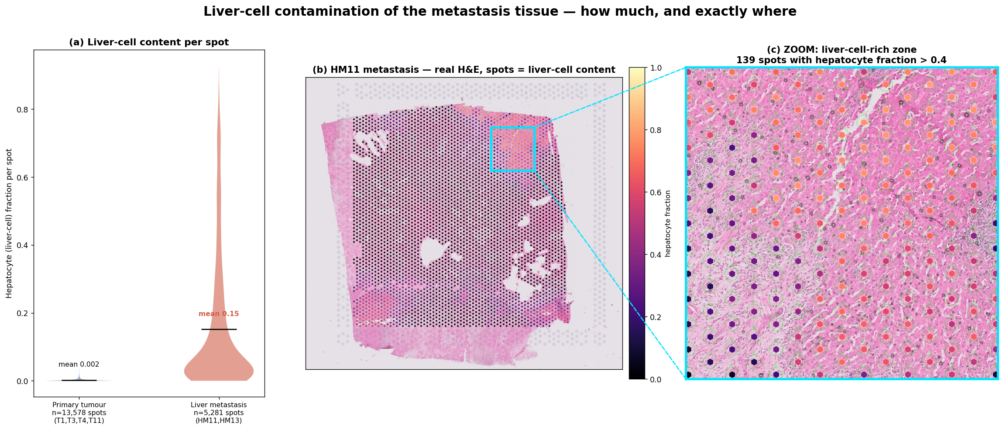
Liver-cell contamination — how much, and exactly where
06
Metastasis spots average ~15% liver cells versus ~0% in primary tumour. On the real slide, zooming into a liver-rich pocket shows the tumour is physically embedded in normal liver.
Notes:
Before trusting any HM-versus-PT signal we quantified the obvious trap. Averaged over all spots, liver metastasis spots are about fifteen percent liver cells, thirteen thousand five hundred primary spots almost none. On the real HM11 whole slide, each spot is coloured by its liver-cell content, and when we zoom into a bright pocket the spots sit squarely on tissue that looks like normal liver. The metastatic tumour is physically embedded in the liver it landed in.

Slide 7
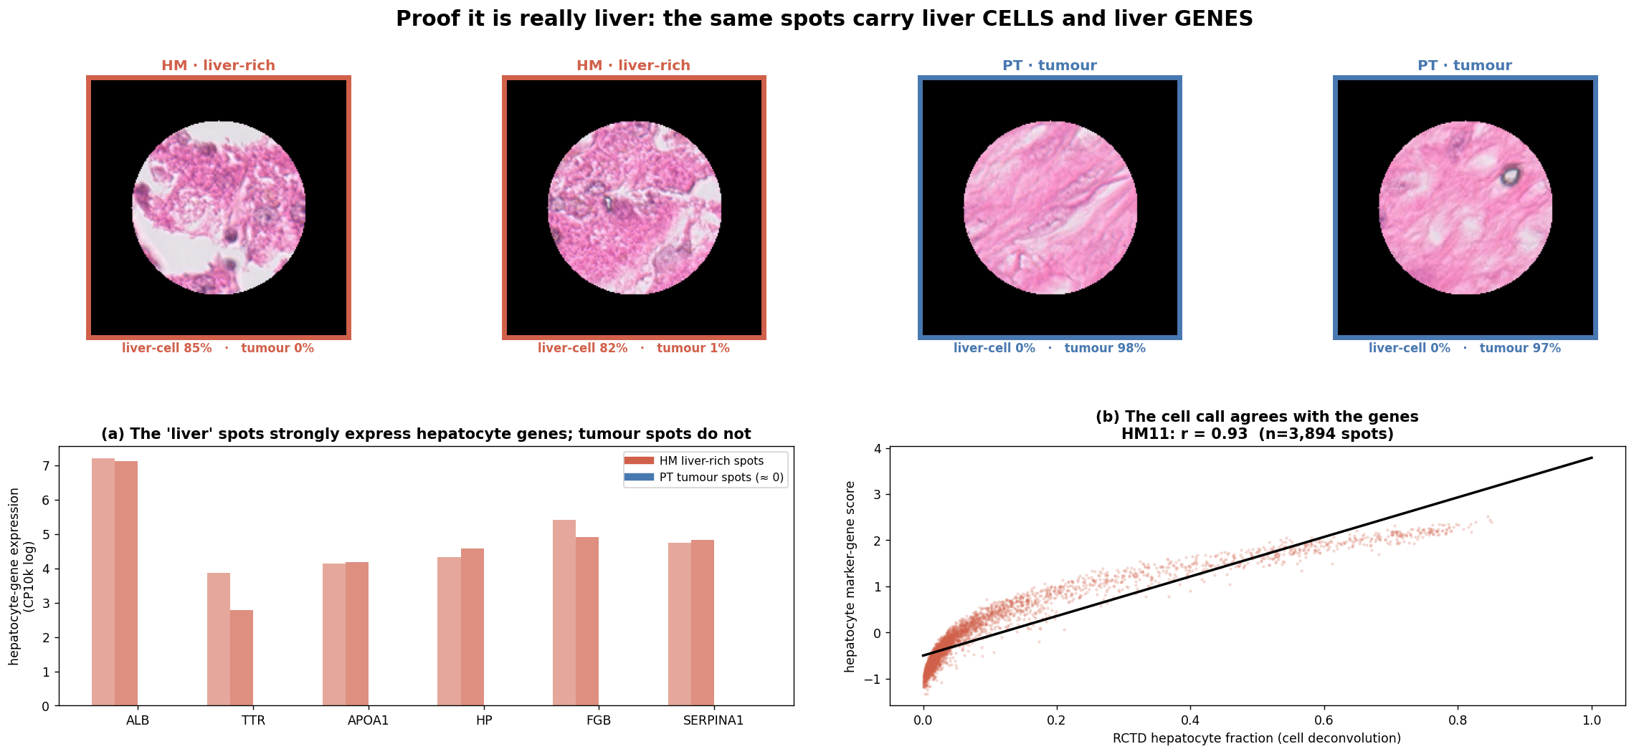
Proof it is really liver — the cells and the genes agree
07
The same spots carry liver cells AND liver genes (ALB, TTR, APOA1). Cell deconvolution and gene expression agree at r = 0.93.
Notes:
This is the proof it is liver and not a deconvolution quirk. Two liver-rich metastasis spots and two primary-tumour spots, each with its own H and E. The metastasis spots strongly express the classic hepatocyte genes, albumin, transthyretin, APOA1, while the tumour spots show essentially none. And across every HM11 spot, the cell-composition liver fraction and the liver-gene score agree almost perfectly, correlation zero point nine three. The liver contamination is real biology.

Slide 8
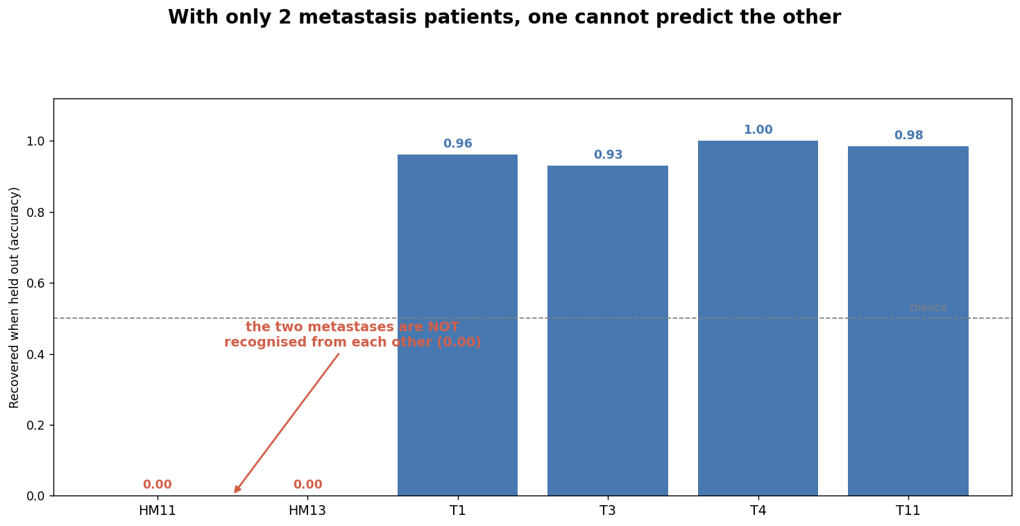
Two metastases do not resemble each other
08
Hold out one sample and predict it from the rest: primary tumours generalise (93–100%), but neither liver metastasis is recovered from the other (0%).
Notes:
The second problem is patient number. Leave one sample out and ask whether the model recognises its tumour type from the others. Primary tumours generalise, ninety three to one hundred percent. But each liver metastasis is not recovered from the other at all, zero percent. With only two metastasis patients there is no transferable, tumour-intrinsic metastasis signature to learn. Together with the liver confound, this is why we do not model the metastasis tissue directly.

Slide 9
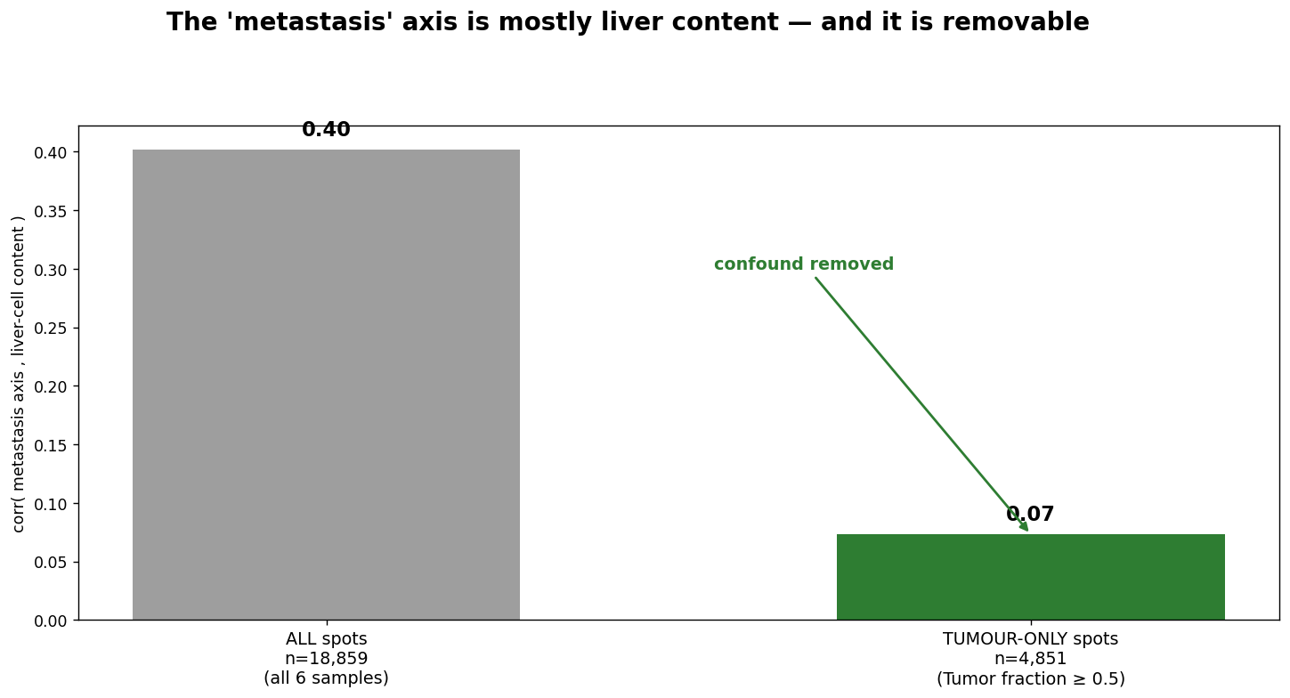
The metastasis axis is mostly liver — and removable
09
Across all 18,859 spots the naive metastasis axis correlates 0.40 with liver content; restricting to the 4,851 tumour-only spots collapses it to 0.07.
Notes:
Putting it together. The naive metastasis direction correlates zero point four with liver-cell content across all eighteen thousand spots from all six samples. Restrict to the four thousand eight hundred tumour-dominated spots, dropping the liver-heavy non-tumour spots, and that correlation collapses to zero point zero seven. Most of the apparent metastasis signal was simply the liver the tumour sits in. So we define the target inside the primary tumour instead, avoiding the confound entirely.

Slide 10
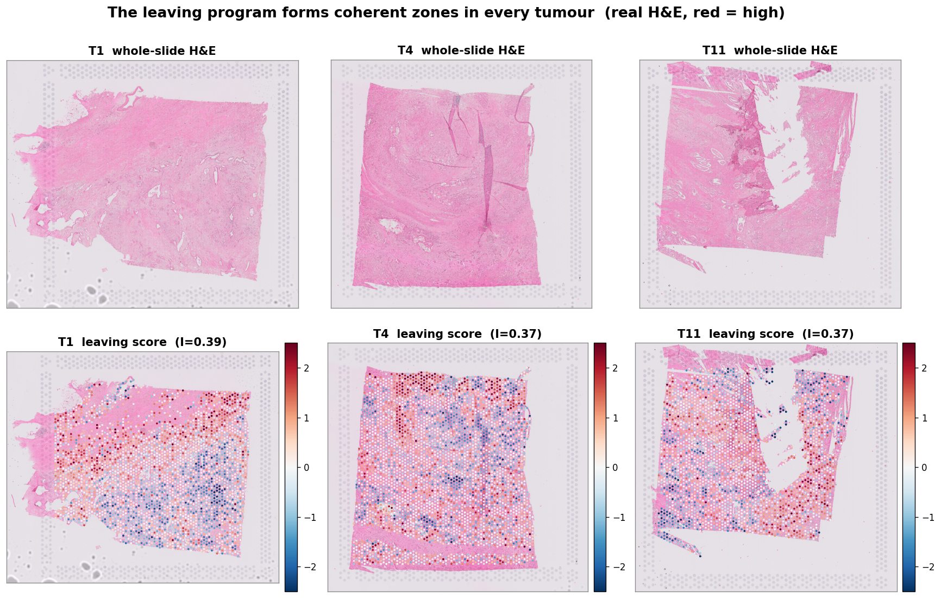
A movement and invasion program inside the tumour
10
High score regions cluster together in every tumour, like invasive fronts, not random noise.
Notes:
This is the leaving program. For each tumour, the H and E is on the left and the score is on the right, on the same tissue. Red marks regions expressing the movement and invasion genes. The high regions form coherent zones in every tumour, which is what you would expect for invasive fronts, and not what random noise looks like.

Slide 11
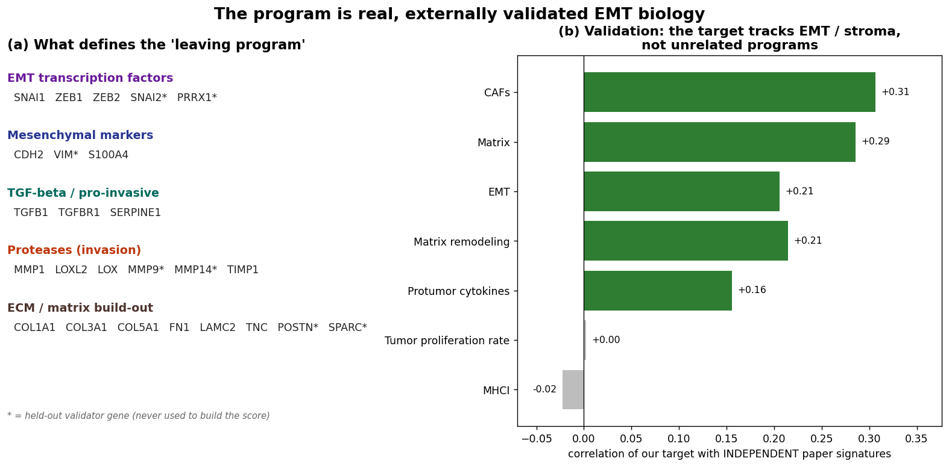
It is real, known EMT biology
11
Built from 19 textbook EMT genes. An independent paper's own EMT score agrees with ours.
Notes:
The score is the average of nineteen well known epithelial to mesenchymal transition and invasion genes, the genes tumours use to detach and move. On the right, computed completely separately, our score lines up with the source paper's own EMT and stroma signatures, and not with unrelated programs. So this is genuine dissemination biology.

Slide 12
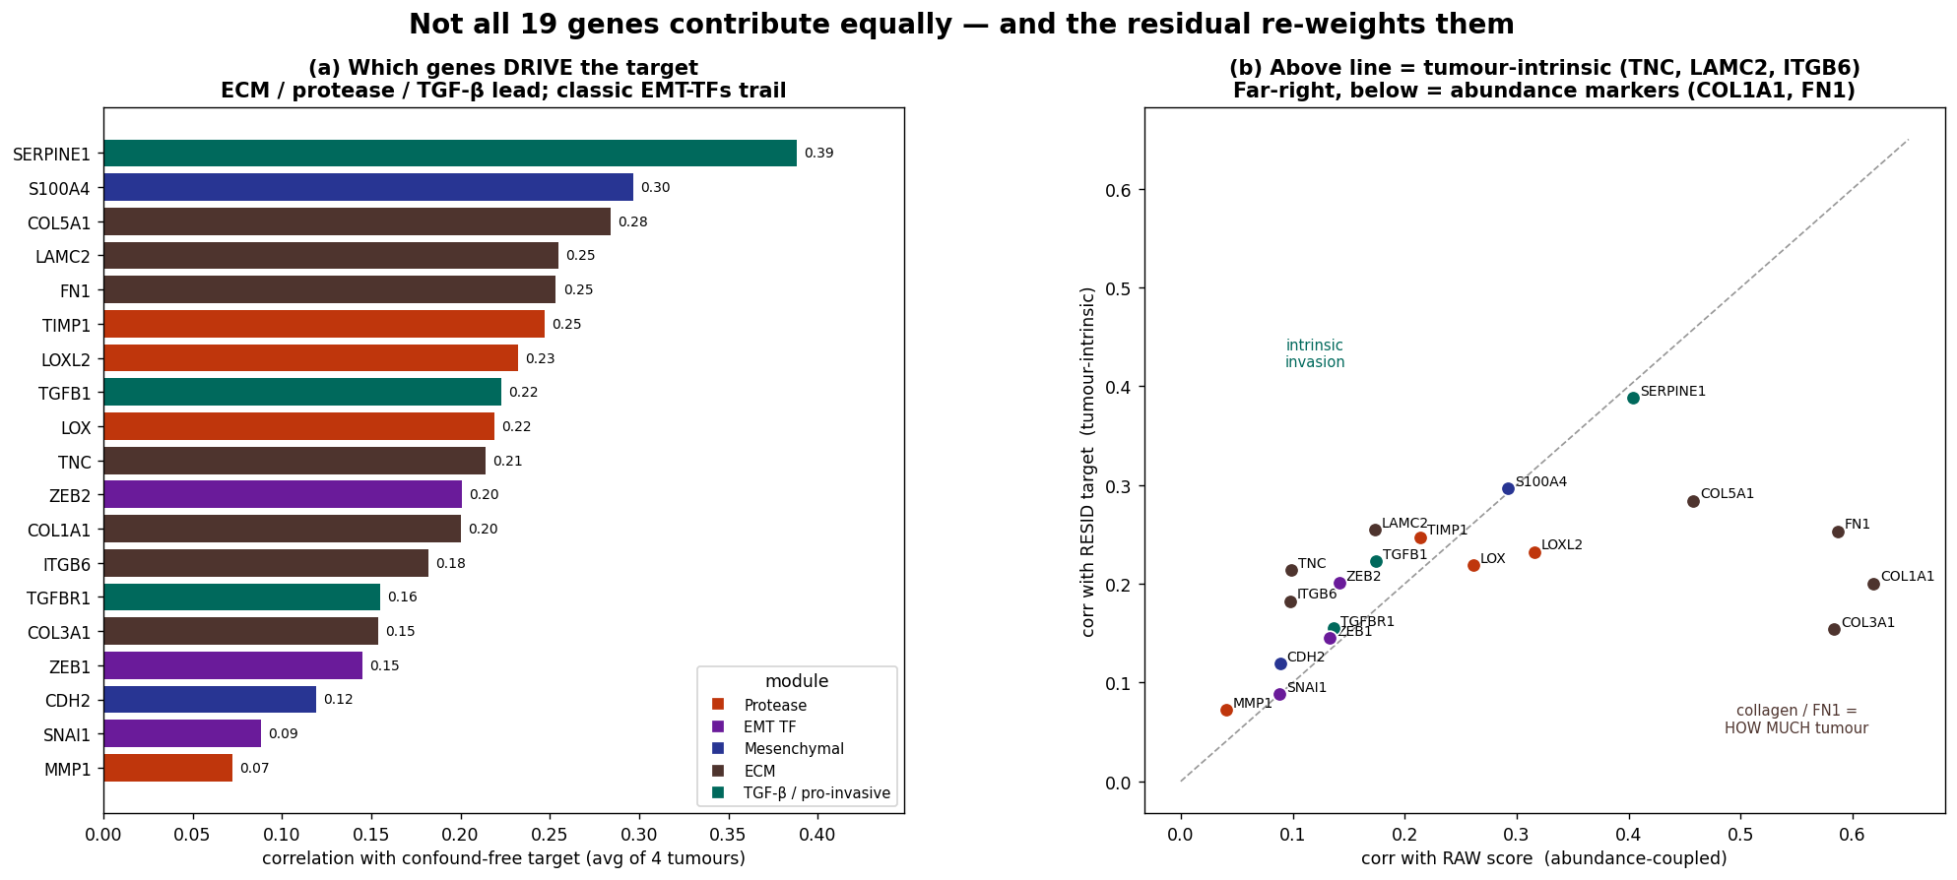
Which genes actually carry the signal
12
The confound-free signal is driven by secreted matrix and protease genes (SERPINE1, S100A4, collagens), not the textbook EMT switches.
Notes:
Not all nineteen genes contribute equally. Averaged over all four tumours, the confound free signal is carried by the secreted matrix and protease genes, SERPINE1, S100A4, collagen five, laminin, fibronectin, and not by the classic transcription factor switches like SNAI1, which are low count and noisy at this fifty five micron resolution. On the right, collagens track how much tumour is present, while tenascin and laminin track the finer intrinsic invasive state. Data driven across all seventeen thousand genes, the top hits are exactly our panel genes, which independently confirms the choice.

Slide 13
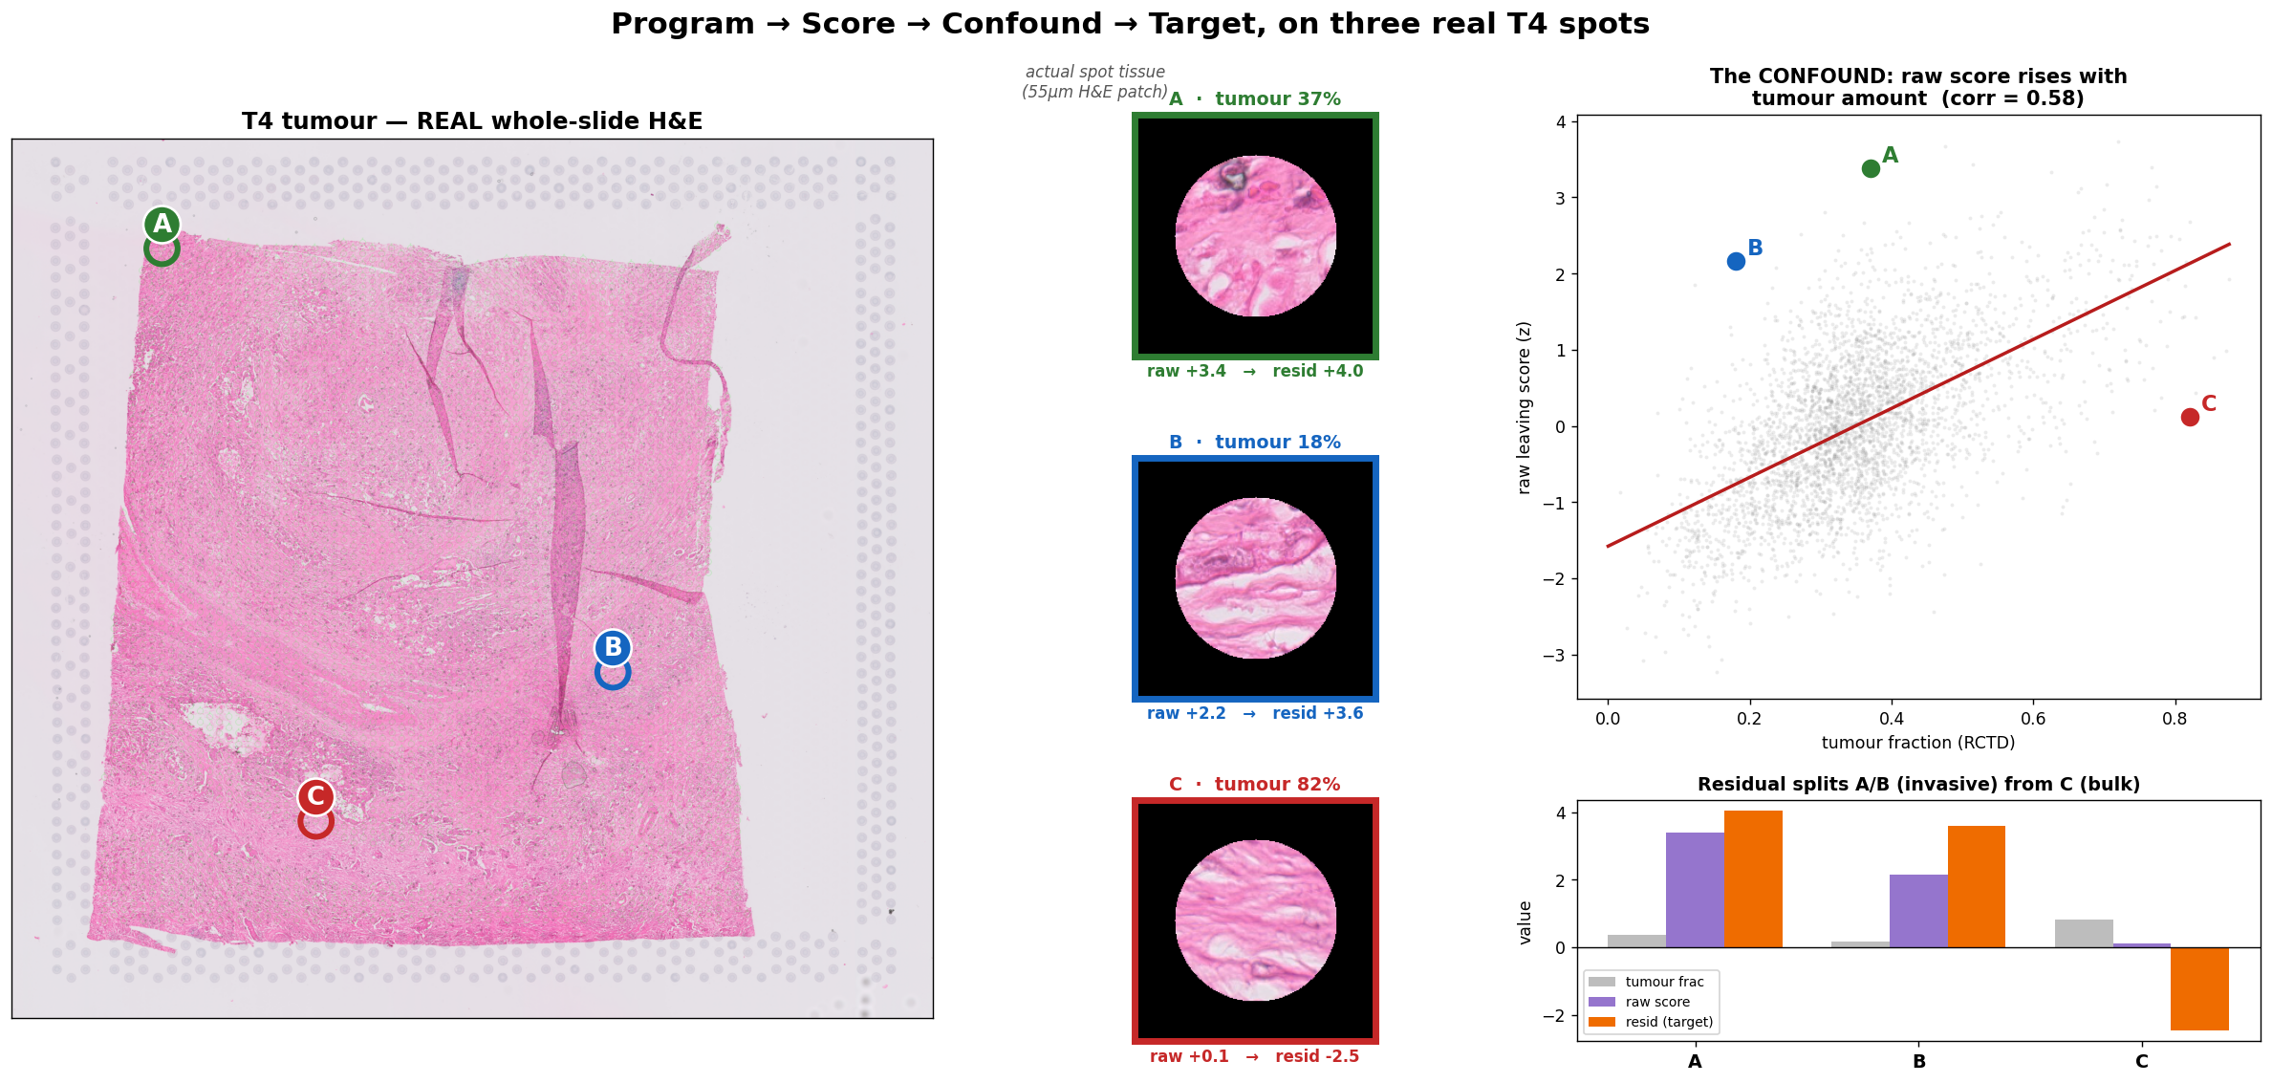
The confound and the fix, on three real spots
13
On the real slide, each spot's own H&E is shown so you can judge it by eye. A dense spot can score high just from more tumour; removing that shows C is bulky, not invasive, while A and B are genuinely leaving.
Notes:
Here is the one confound that could fool us, made concrete on three real spots from tumour four, shown on the actual whole slide with each spot's own H&E patch so a pathologist can check every call by eye. The raw score climbs with tumour amount, the red line. Spot C has eighty two percent tumour but is a bulky sheet, not invasive. Spots A and B have less tumour but fibrous, infiltrative edges and strongly express the program. After we remove the tumour amount effect, A and B stay high while C flips negative. That corrected residual is the target we actually model, so we measure invasiveness, not density.

Slide 14
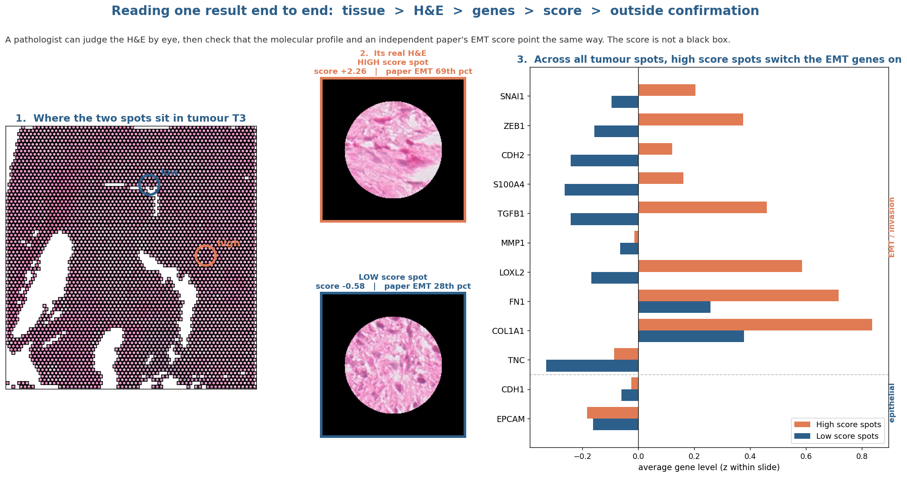
Reading one result end to end
14
Location, then H&E you can judge by eye, then genes, then score, then outside confirmation. Not a black box.
Notes:
Here is one result made fully traceable. Two real tumour spots, one high and one low. You can see where each sits, then its actual H and E, where the high spot looks pink and fibrous and the low one densely cellular. On the right, across all tumour spots, the high score spots switch the EMT genes on while the epithelial genes stay flat. And each spot also carries an outside paper's EMT score that agrees. A pathologist can check every step.

Slide 15
PART 03
From transcriptomics to a plain slide
What a plain H&E can do
How far the slide alone gets us on patients it never saw
Notes:
Now the real test. Can the slide alone reproduce the signal on new patients, which is the clinical promise.

Slide 16
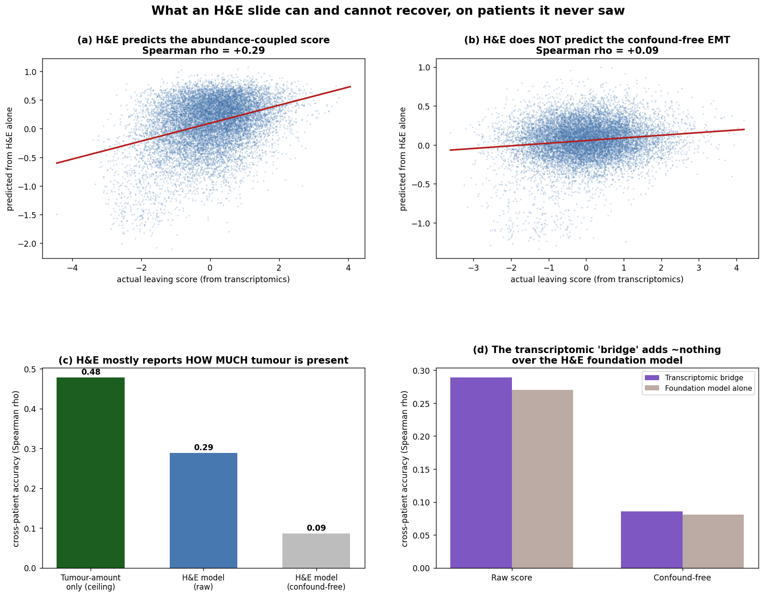
What an H&E slide can and cannot tell us
16
The slide reliably reads how much tumour is present. The finer movement signal is not yet readable across patients.
Notes:
On new patients the slide reproduces the raw score moderately. But once we remove the simple how much tumour is here effect, the finer movement signal drops to the noise floor. A trivial tumour amount predictor actually beats our model. And adding the transcriptomic bridge did not beat the foundation model on its own. So today the slide mainly senses tumour amount, not the fine metastatic state. This is the honest ceiling, and it is better to know it now.

Slide 17
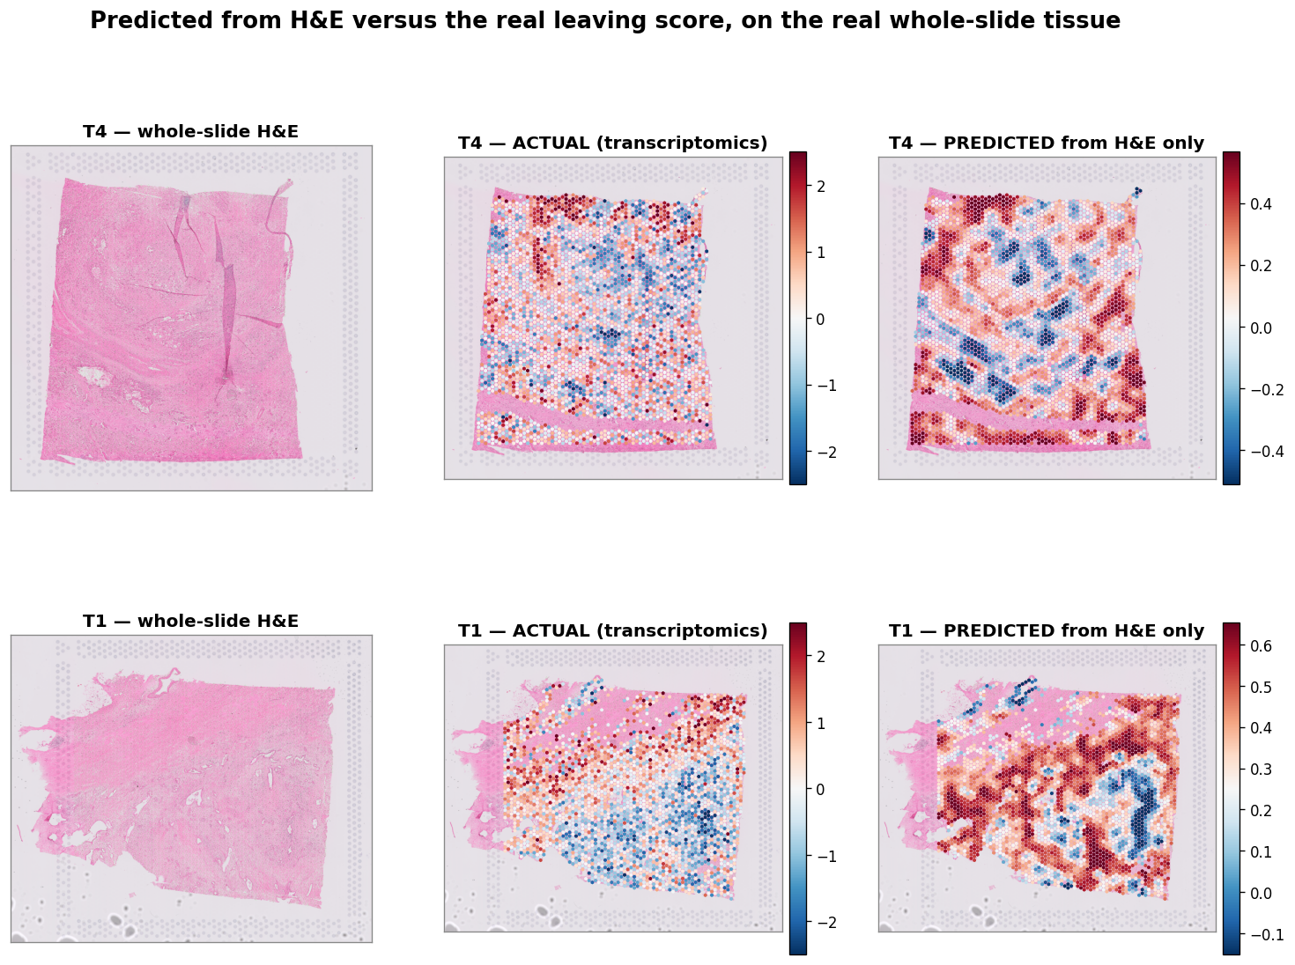
The same result, drawn on the tissue
17
The H&E prediction follows the broad pattern and smooths away the finer detail.
Notes:
The same story as a picture. For two tumours, the actual score and the score predicted from the slide alone. The prediction follows the broad high and low zones, which track tumour density, and it smooths away the finer structure. This is the visual version of the ceiling on the previous slide.

Slide 18
PART 04
Where we stand
What we learned and next
An honest scorecard, and the steps that would push this further
Notes:
To close, an honest scorecard against pre stated tests, then the steps that would move it forward.

Slide 19
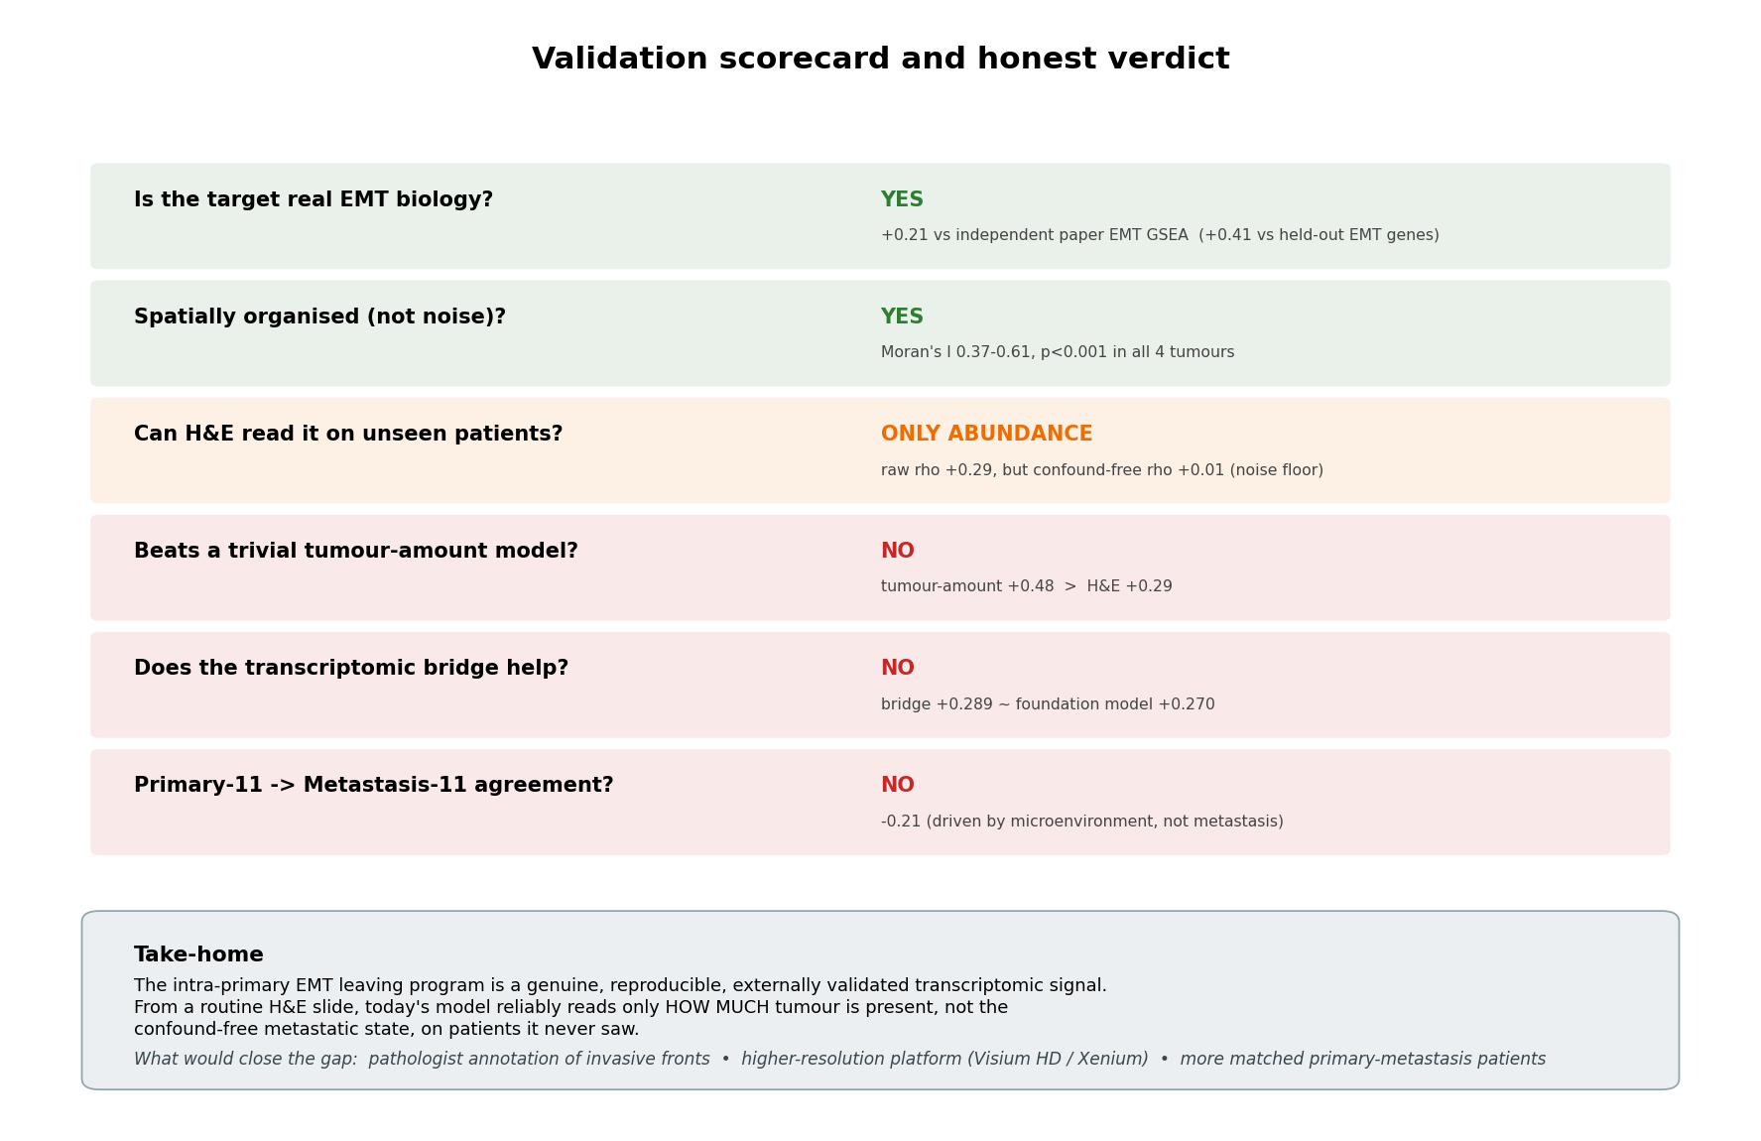
Scorecard and honest verdict
19
The program is real and validated. The slide today reads tumour amount, not the confound free state, on new patients.
Notes:
Six checks we set in advance. The target is real EMT and spatially organised, both yes. The slide reads only the tumour amount part, it does not beat a trivial tumour amount model, the transcriptomic bridge did not help, and the primary to metastasis link in patient eleven did not hold. This is a clean, confound checked result. The biology is real, the slide read out is amount limited at this resolution.

Slide 20
What would push this further
20
STEP 01
STEP 02
STEP 03
Pathologist annotation
Higher resolution
More matched patients
Mark invasive fronts on a few slides so we can test the signal against expert ground truth, not just transcriptomics.
Move from 55 micron spots to Visium HD or Xenium, so a spot is closer to a single cell and fine signal survives.
Add patients that have both a primary tumour and its own liver metastasis, so the link can be learned, not guessed.
The biology is already real and validated. These steps are about the read out from the slide, not about the signal existing. All three can run in parallel.
Notes:
None of these change the finding that the program is real. They are about making the slide able to read the finer state. Annotation gives us expert ground truth. Higher resolution gives cleaner signal per spot. More matched patients let the primary to metastasis link be learned directly.

Slide 21
Thank you
The intra-primary EMT leaving program is genuine and externally validated.
A routine H&E slide currently reads how much tumour is present, and not yet the finer
metastatic state on new patients. Your feedback on the invasive front annotation would help most.
Spatial Transcriptomics Research | 29 June 2026
Notes:
Happy to take questions. The one ask that would move us fastest is a small set of slides with the invasive fronts marked, so we can test the score against your read rather than against transcriptomics alone.

